Slide 1
BASICS OF MACHINE LEARNING
Akash Gujju, Dharan Kumar

Slide 2
INDEX
What is Machine Learning?
AI V/s ML.
Why is Machine Learning popular now?
Where can Machine Learning be used?
Supervised V/s Unsupervised Learning
Types of ML Algorithms.
Steps involved in Machine Learning.

Slide 3
A machine learning on its own

Slide 4
What is Machine Learning?
Machine learning is an application of artificial intelligence (AI) that provides systems the ability to automatically learn and improve from experience without being explicitly programmed.
Machine learning focuses on the development of computer programs that can access data and use it learn for themselves.

Slide 5
Abstraction Layers Of A.I.

Slide 6
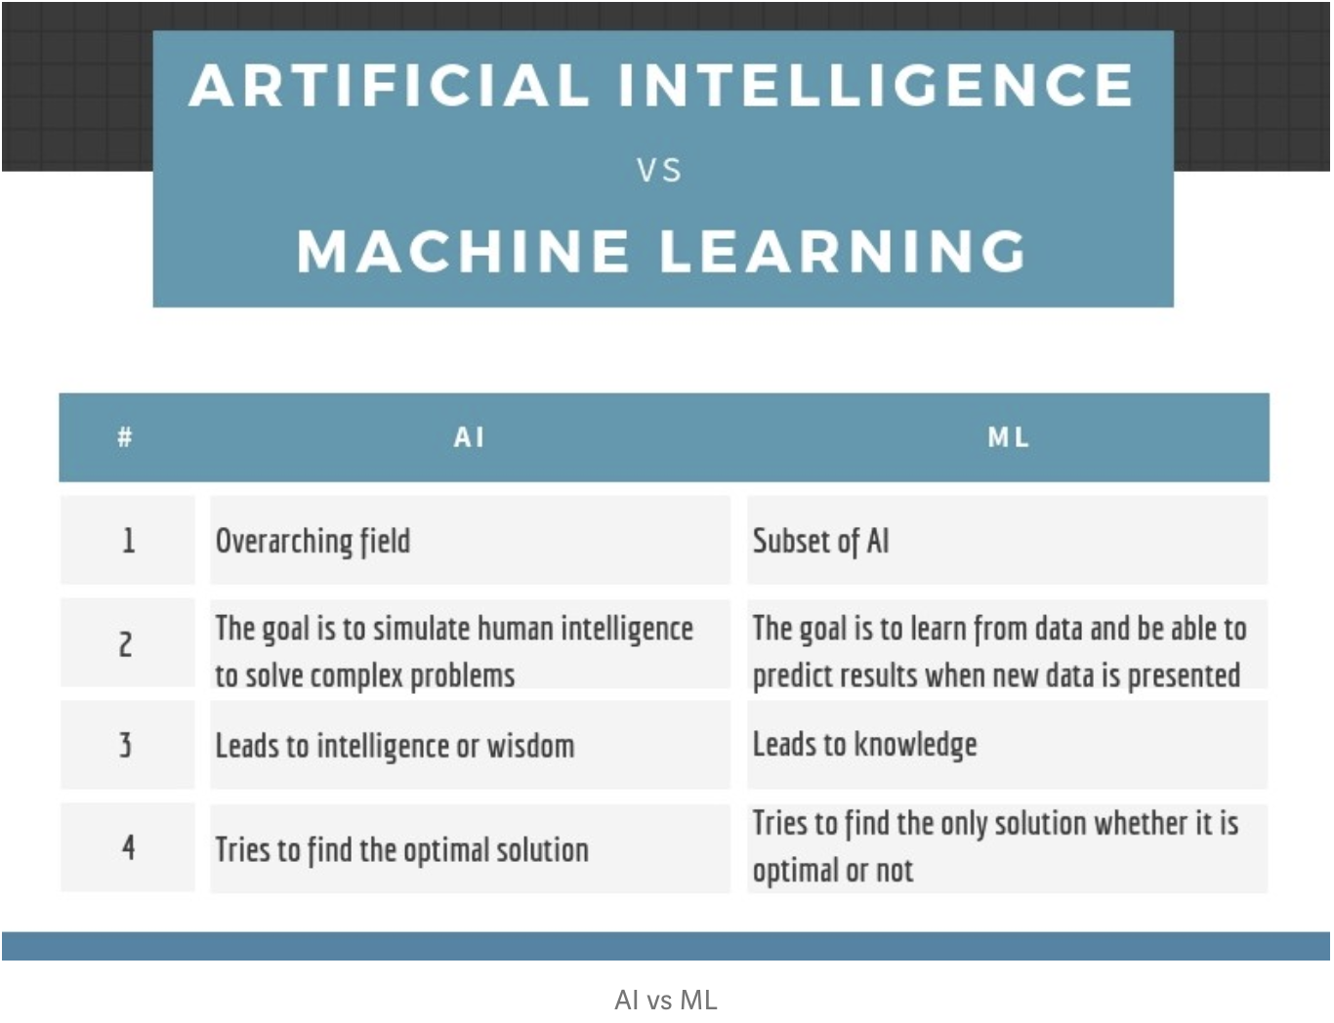

Slide 7
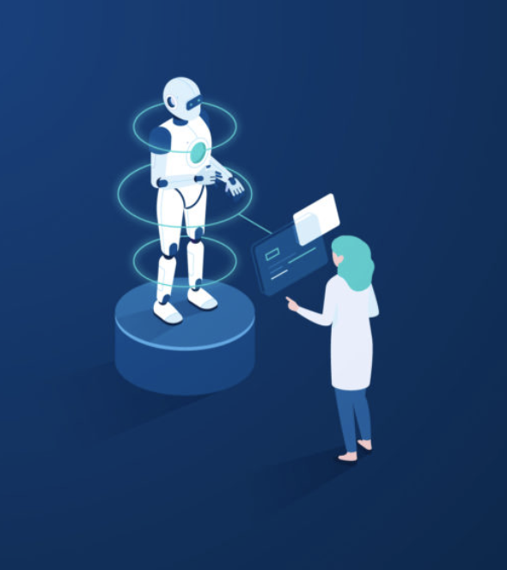
Why is Machine Learning popular now?
Data is available everywhere.
Computers are much more powerful
Can be integrated into the current business requirements.

Slide 8
Where can Machine Learning be used?
Recommender Engines.
Personal Assistants.
Optical Character Recognition.
Advertising and Business Intelligence.
Predictive Analysis.
Facial Recognition, etc.

Slide 9

Recommender Engines
A recommendation system is an extensive class of web applications that involves predicting the user responses to the options.
Amazon, they have been using a recommendation engine for suggesting the goods or products that customers might also like.

Slide 10
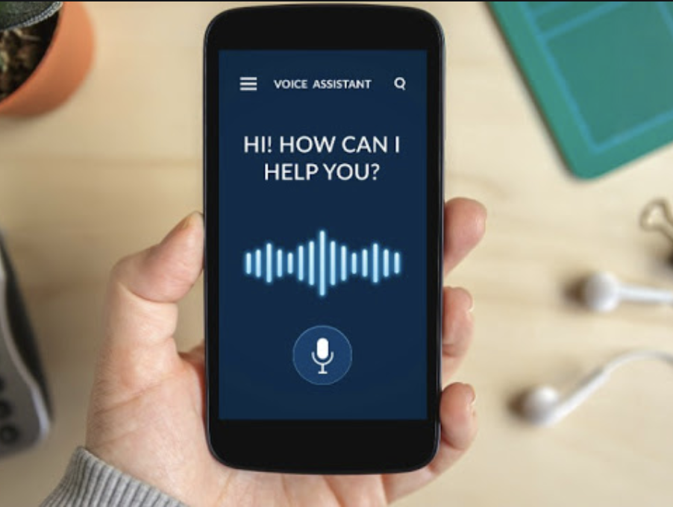
Personal Assistant
Many tech giants like Amazon, Google and Apple all have their personal assistants whose main goal is to understand their user and aid them in their day to day tasks.

Slide 11
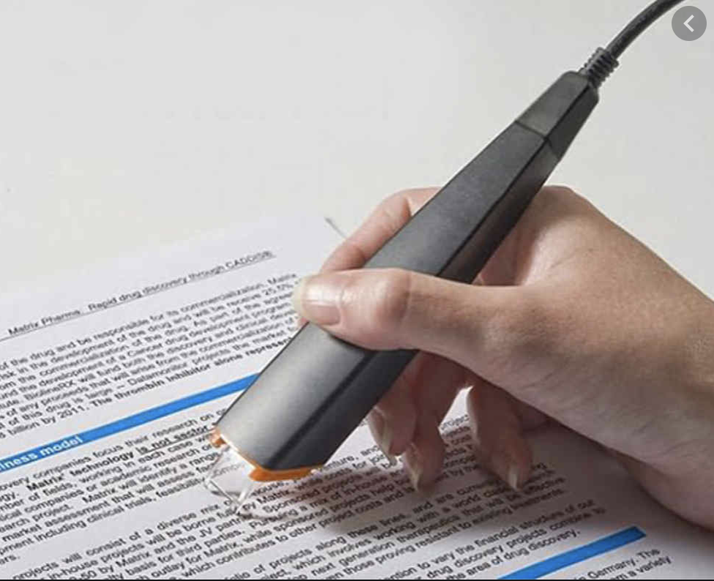
Optical Character Recognition
It converts scanned images into readable texts.
Can be used for handwriting detection, reading physical documents, etc.

Slide 12
Advertising And Business Intelligence
It can help give user specific ads.
It can help to make complex business decisions.
It can make predictions for investments.

Slide 13
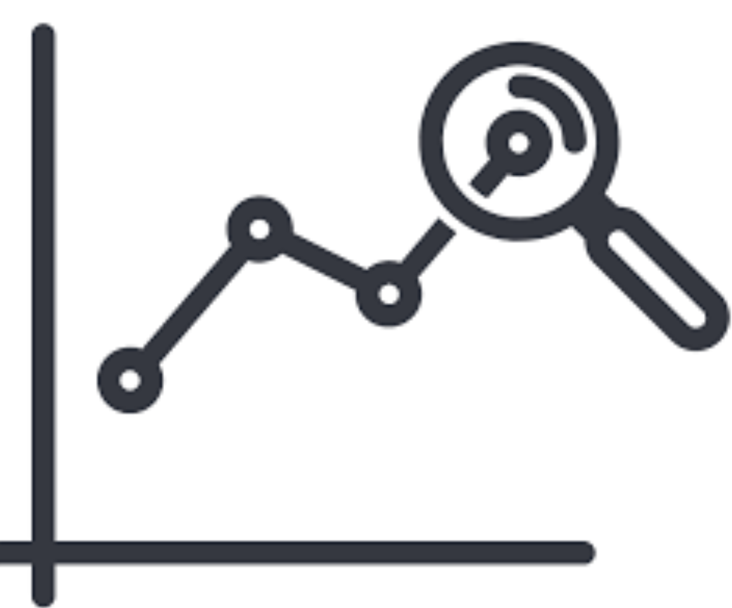
Predictive Analysis
It can be used to make predictions like:
Stock Market Price Predictions.
Disease Predictions.
Business predictions

Slide 14
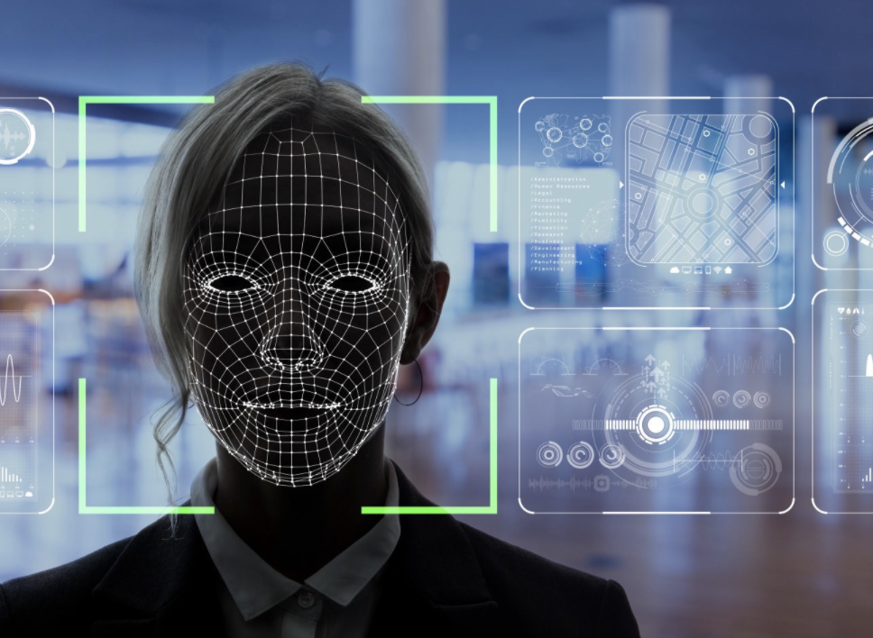
Facial Recognition
Face Recognition is a recognition technique used to detect faces of individuals whose images saved in the data set.
Facebook currently is able to recognise your friends with an accuracy of 98%.

Slide 15
Supervised V/s Unsupervised Learning
Supervised Learning
Unsupervised Learning
Uses Training Dataset
Procedure is complex
Used for prediction
Number of classes is known
Algorithms used: Regression, Classification
Uses Input Dataset
Procedure is relatively simple
Used for analysis
Number of classes is unknown
Algorithms used: Clustering, Association

Slide 16
Types Of Machine Learning Algorithms
Regression
Classification
Clustering
Association
Reinforcement Learning

Slide 17
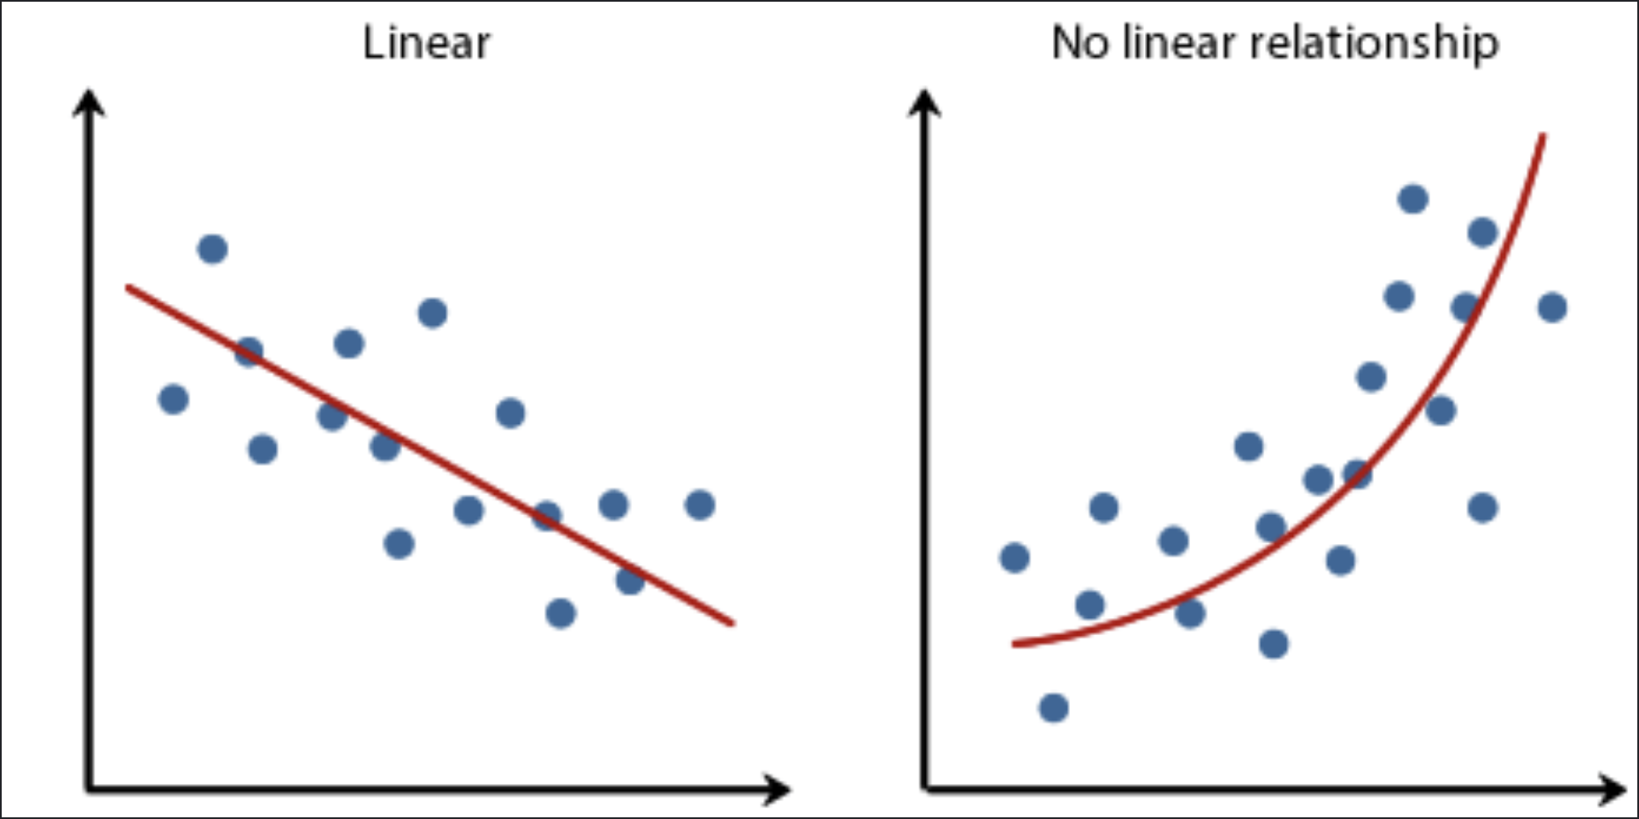
Regression
Regression is a ML algorithm that can be trained to predict real numbered outputs; like temperature, stock price, etc. Regression is based on a hypothesis that can be linear, quadratic, polynomial, non-linear, etc.

Slide 18
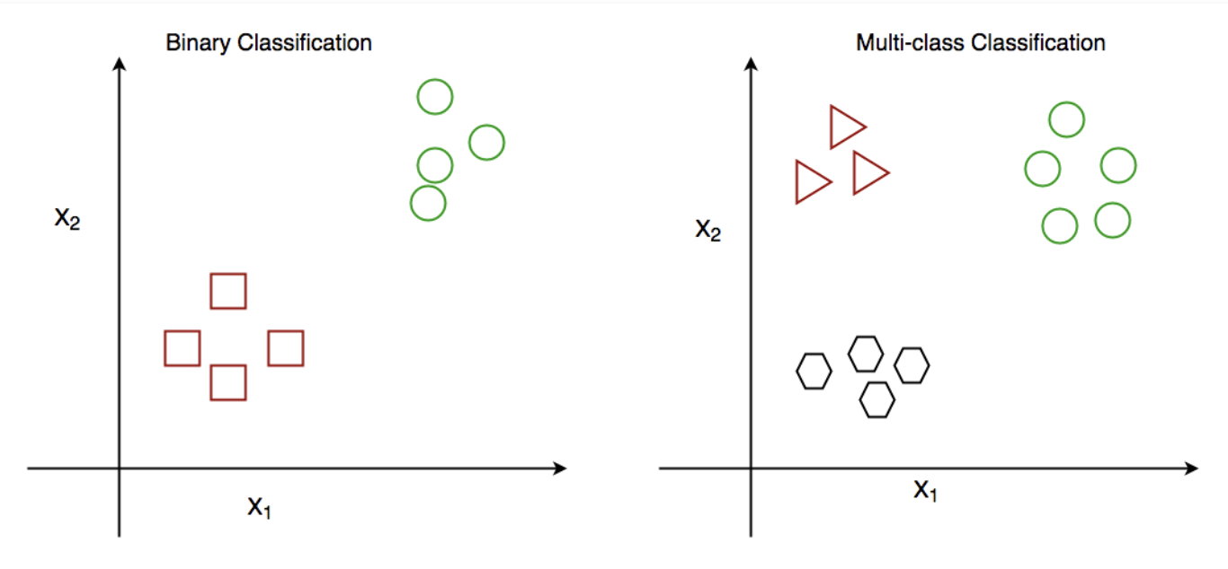
Classification
Classification is the problem of identifying to which of a set of categories (sub-populations) a new observation belongs, on the basis of a training set of data containing observations (or instances) whose category membership is known.
The term "classifier" sometimes also refers to the mathematical function, implemented by a classification algorithm, that maps input data to a category.

Slide 19
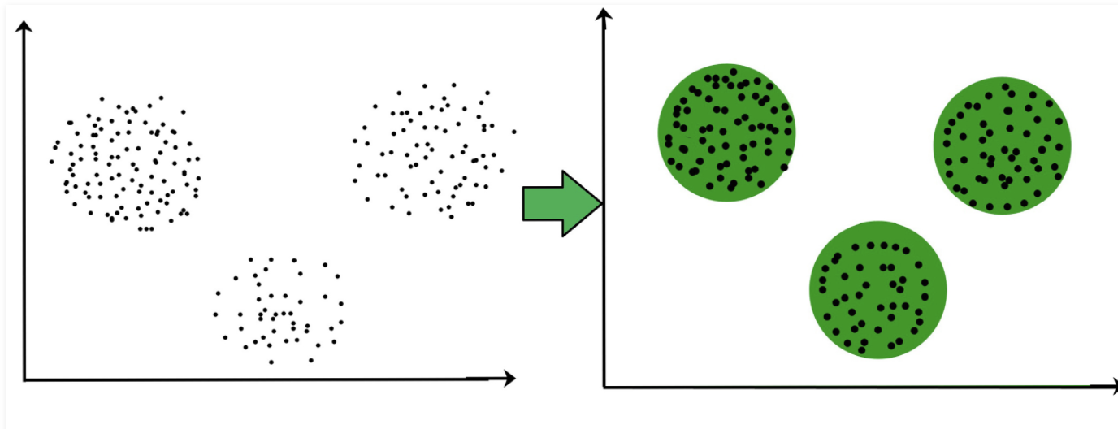
Clustering
Clustering is the task of dividing the population or data points into a number of groups such that data points in the same groups are more similar to other data points in the same group and dissimilar to the data points in other groups. It is basically a collection of objects on the basis of similarity and dissimilarity between them.

Slide 20
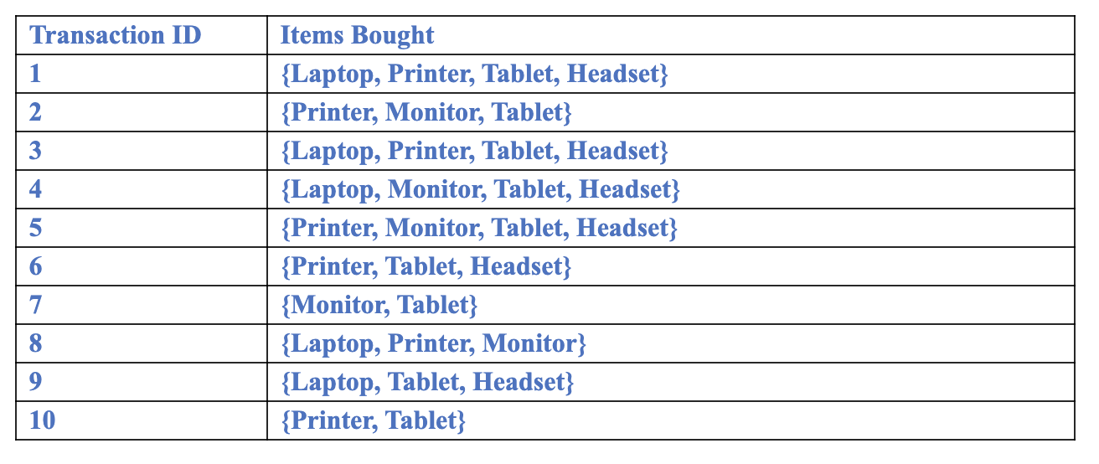
Association Rule Mining
Association rule learning is a rule-based machine learning method for discovering interesting relations between variables in large databases. It is intended to identify strong rules discovered in databases using some measures of interestingness.

Slide 21
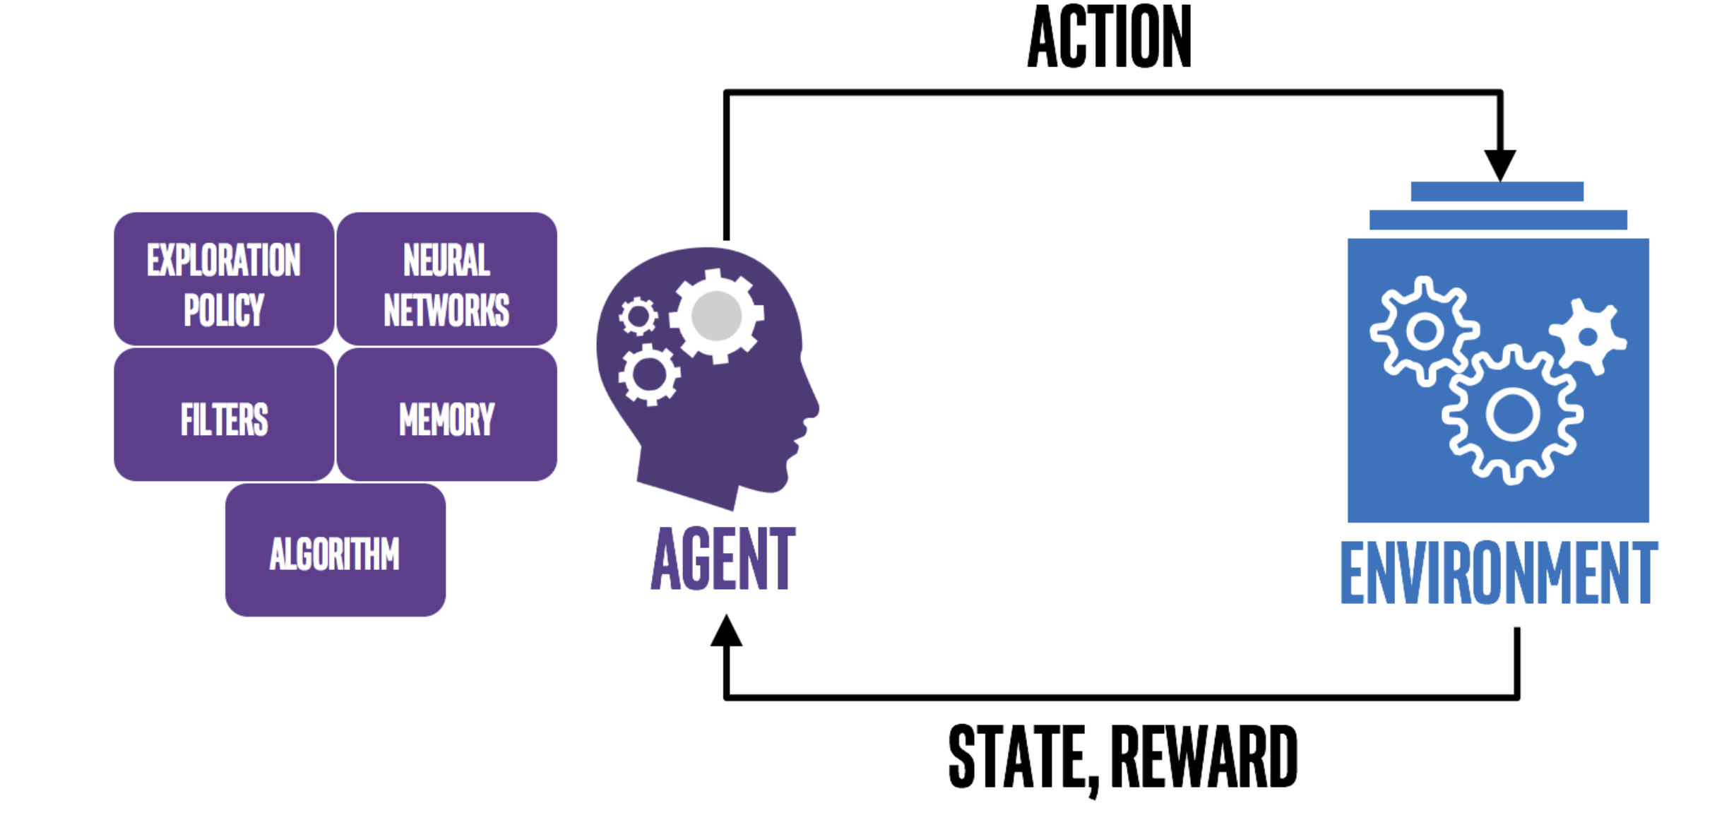
Reinforcement Learning
Reinforcement learning is the training of machine learning models to make a sequence of decisions. The agent learns to achieve a goal in an uncertain, potentially complex environment. In reinforcement learning, an artificial intelligence faces a game-like situation. The computer employs trial and error to come up with a solution to the problem.

Slide 22
Steps In Machine Learning

Slide 23
Q & A

Slide 24
THE END

